Slide 1
Chapter 2: Transmission Fundamentals_Part_1

Slide 2
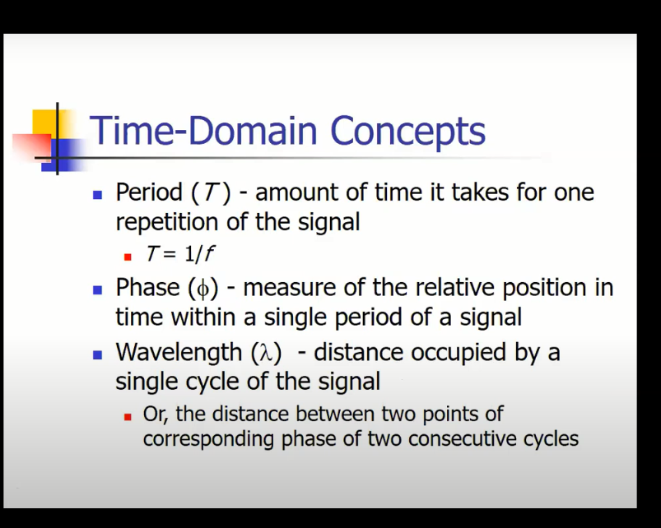

Slide 3
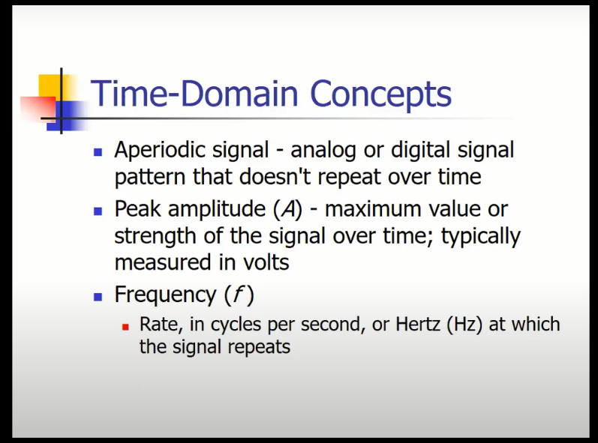

Slide 4
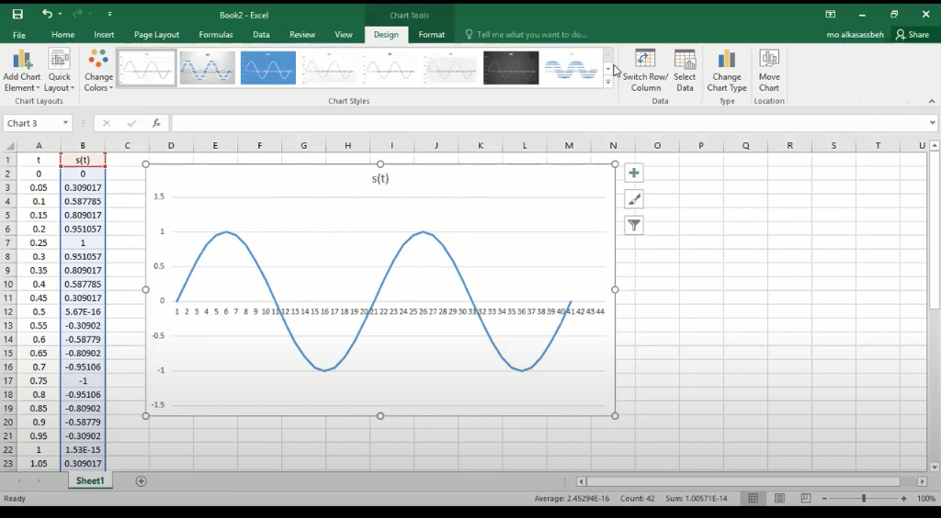

Slide 5
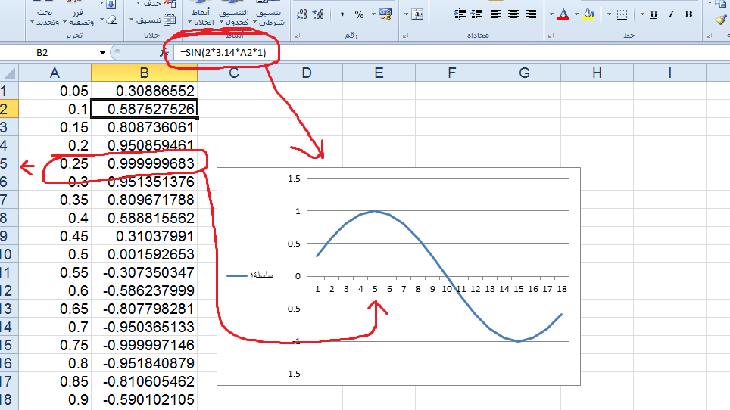

Slide 6
Sine wave parameters
General sine wave
s(t ) = A sin(2πft + φ)
Figure 2.3 shows the effect of varying each of the three parameters
(a) A = 1, f = 1 Hz, φ = 0; thus T = 1s
(b) Reduced peak amplitude; A=0.5
(c) Increased frequency; f = 2, thus T = ½
(d) Phase shift; φ = π/4 radians (45 degrees)
note: 2π radians = 360° = 1 period

Slide 7
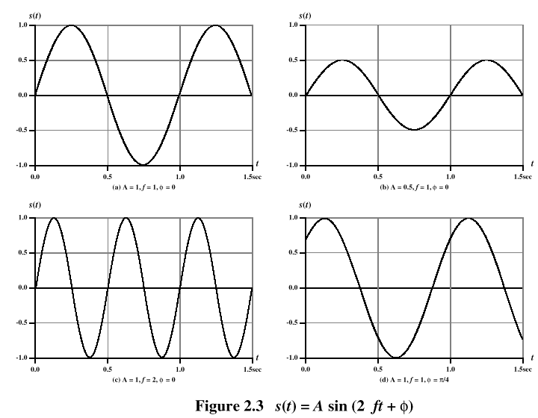

Slide 8
Frequency-Domain Concepts
Fundamental frequency - when all frequency components of a signal are integer multiples of one frequency, it’s referred to as the fundamental frequency.
Spectrum - range of frequencies that a signal contains.
Absolute bandwidth - width of the spectrum of a signal .
Effective bandwidth (or just bandwidth) - narrow band of frequencies that most of the signal’s energy is contained in.

Slide 9
Frequency-Domain Concepts
Any electromagnetic signal can be shown to consist of a collection of periodic analog signals (sine waves) at different amplitudes, frequencies, and phases .
The period of the total signal is equal to the period of the fundamental frequency .

Slide 10
Relationship between Data Rate and Bandwidth
The greater the bandwidth, the higher the information-carrying capacity.
Conclusions:
Any digital waveform will have infinite bandwidth.
BUT the transmission system will limit the bandwidth that can be transmitted.
AND, for any given medium, the greater the bandwidth transmitted, the greater the cost.
HOWEVER, limiting the bandwidth creates distortions .

Slide 11
Data Communication Terms
Data - entities that convey meaning, or information .
Signals - electric or electromagnetic representations of data .
Transmission - communication of data by the propagation and processing of signals .

Slide 12
Examples of Analog and Digital Data
Analog
Video
Audio
Digital
Text
Integers

Slide 13
Analog Signals
A continuously varying electromagnetic wave that may be propagated over a variety of media, depending on frequency
Examples of media:
Copper wire media (twisted pair and coaxial cable)
Fiber optic cable
Atmosphere or space propagation
Analog signals can propagate analog and digital data

Slide 14
Digital Signals
A sequence of voltage pulses that may be transmitted over a copper wire medium .
Generally cheaper than analog signaling .
Less susceptible to noise interference .
Suffer more from attenuation .
Digital signals can propagate analog and digital data .

